Slide 1
ITU-T search tools and
MyWorkspace
November 2017

Slide 2
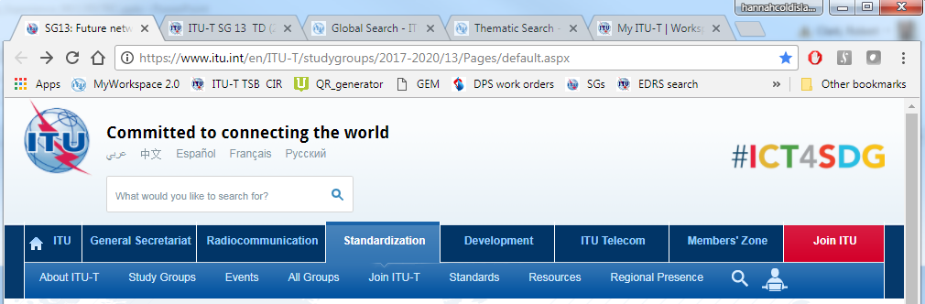

What’s new?
Updates to:
Global search engine: Deep search of public and
member-only resources within ITU
Thematic search: Emerging concepts across ITU-T
MyWorkspace: Personalized web tools and services
Global search/
thematic search
MyWorkspace

Slide 3
ITU-T global search
More accurate and complete results
Richer information: Document history, references
Sector-specific searches (or all ITU)
Not just documents (Work Programme, webpages, etc.)
www.itu.int/net4/ITU-T/search/GlobalSearch/Landing

Slide 4
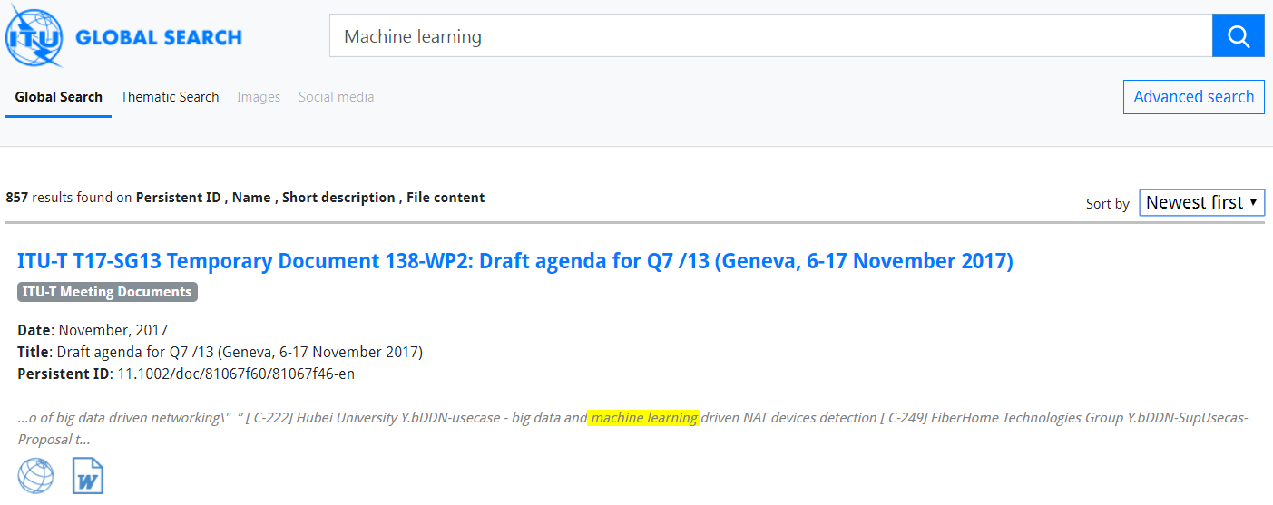

ITU-T global search:
Look inside TIES-protected content
Search for anything
(14 collections; 200k plus indexed documents)
Sort results by
relevance or newness
Search probes inside the content
of TIES-protected resources

Slide 5
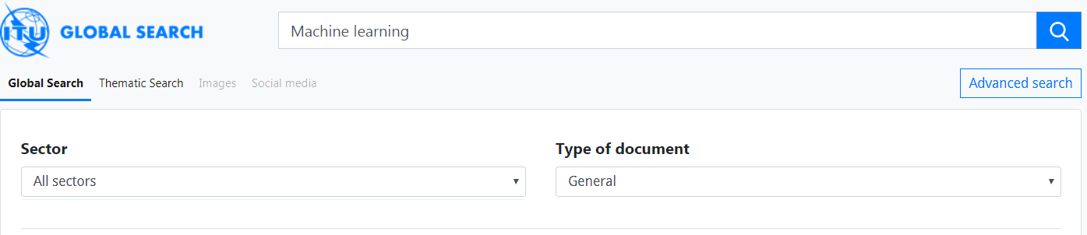
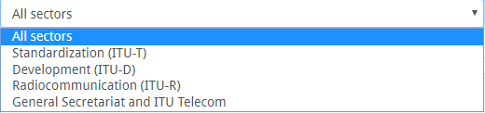
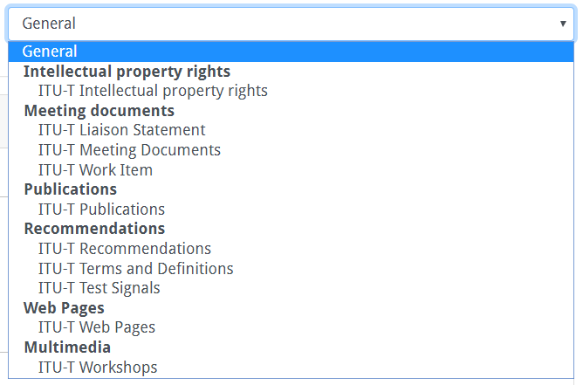
ITU-T global search:
Advanced search
Refine your search

Slide 6
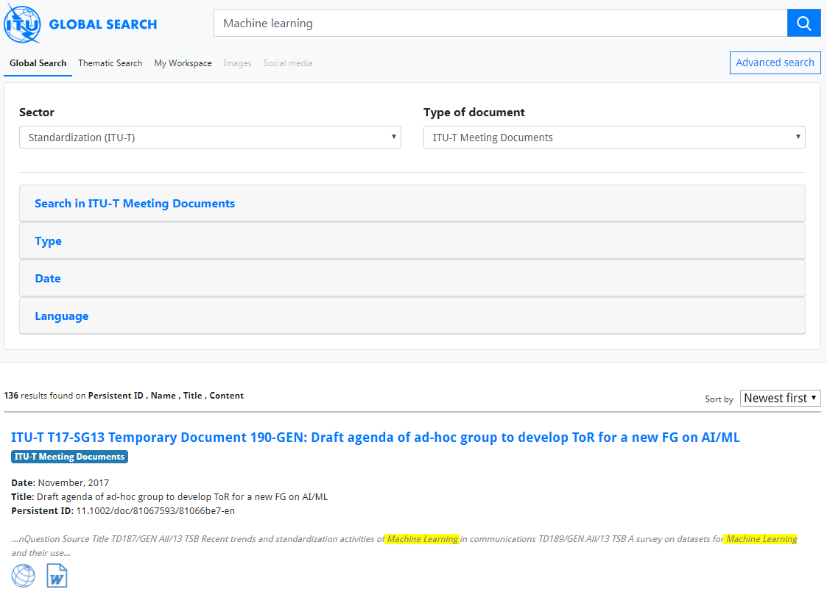
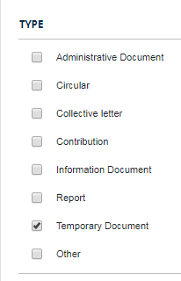
ITU-T global search:
Advanced search

Slide 7
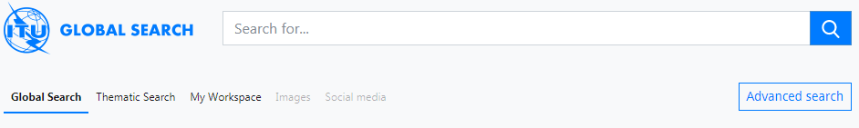

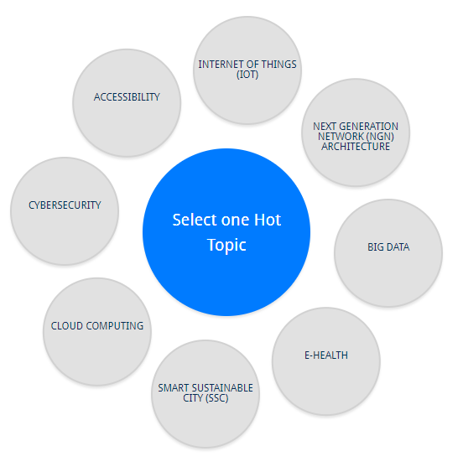
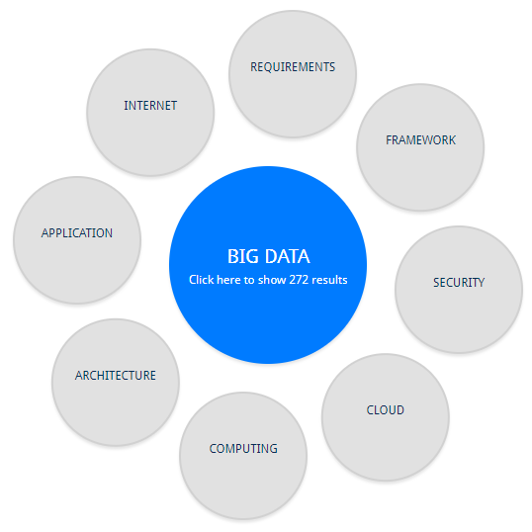
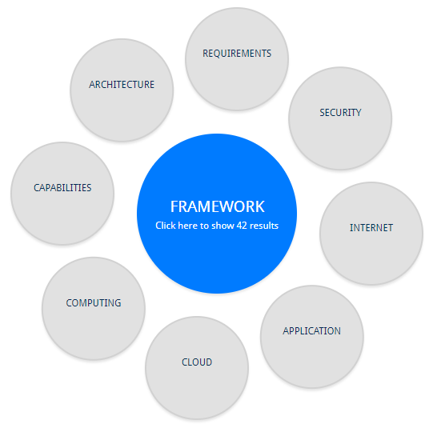

ITU-T thematic search
42 results…
…click to list them

Slide 8
ITU-T MyWorkspace
www.itu.int/net4/ITU-T/myworkspace

Slide 9
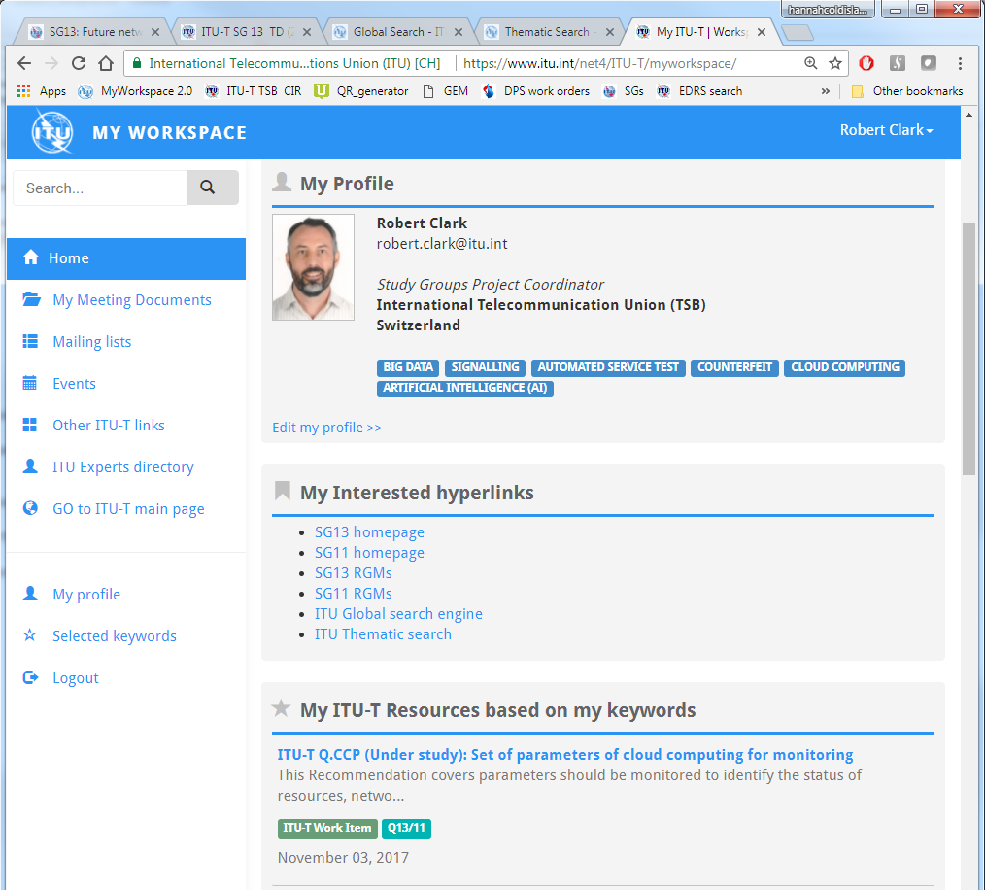
ITU-T MyWorkspace:
A personalized view of ITU-T
Define your own
profile
(groups, keywords, etc.)
Choose your own
favourite URLs
Personalized view
of ITU-T resources

Slide 10
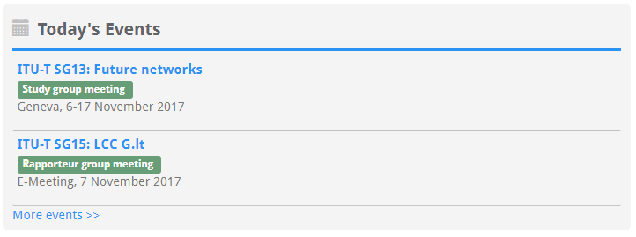
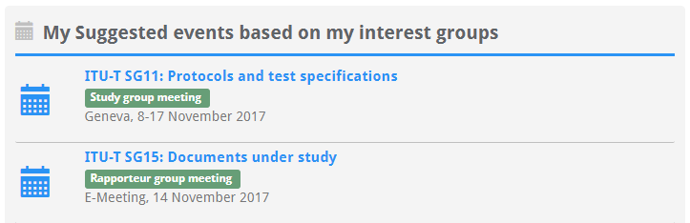
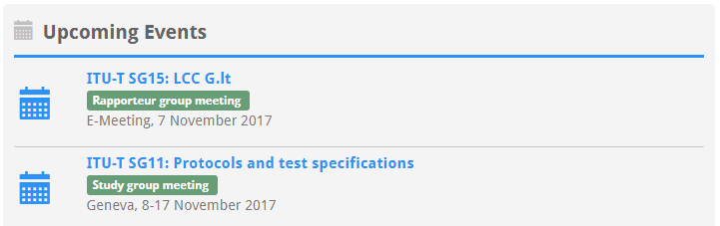
ITU-T MyWorkspace:
A personalized view of ITU-T
Personalized list of
meeting documents
Find and subscribe
to mailing lists
Today’s ITU-T
events
Personalized view of events schedule
Selected forthcoming
meetings of interest
Quick links to other
tools/services
Network with other
ITU-T experts
All forthcoming
meetings

Slide 11
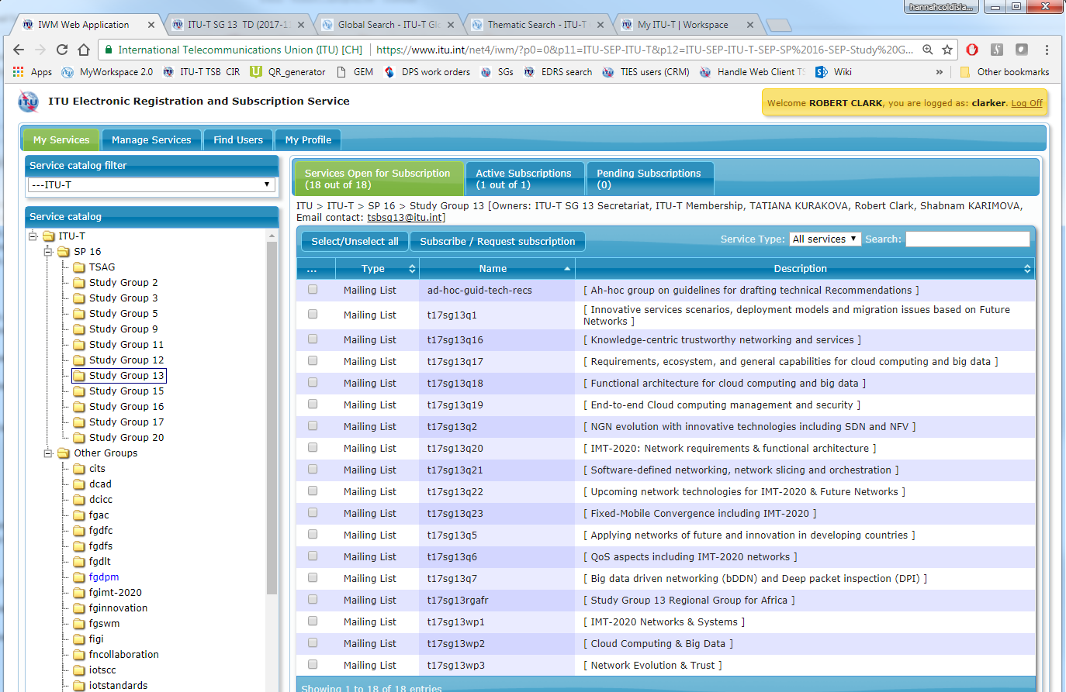
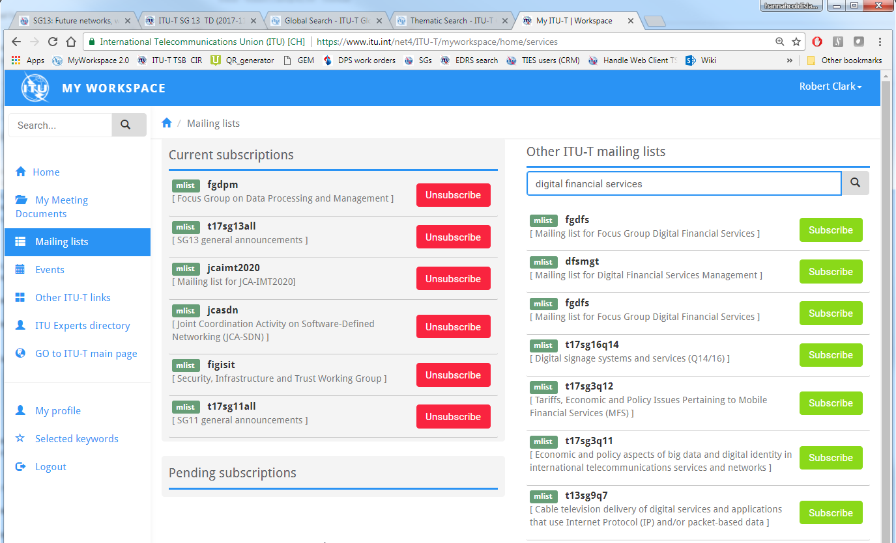
ITU-T MyWorkspace:
Manage mailing list subscriptions
Search by group name,
key phrases, etc.
Unsubscribe from
current services
Subscribe with
one click
Coming soon – subscription directly from group websites

Slide 12
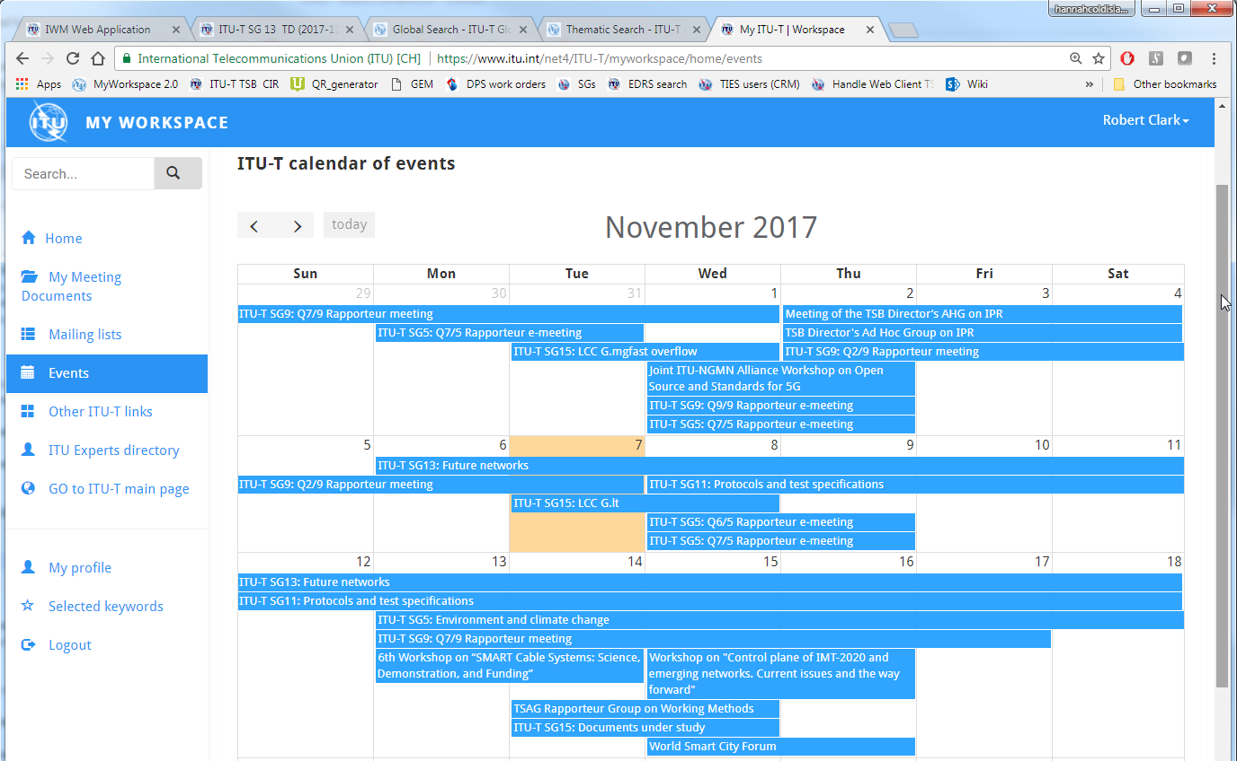
ITU-T MyWorkspace:
Events
Calendar view of all ITU-T events: study group, working party,
regional group, rapporteur group, and non-statutory
Click on an event to see group-
or meeting-specific information

Slide 13
Thank you
Any requests, feedback,
or questions?
Email: tsbitdev@itu.int

