Slide 1
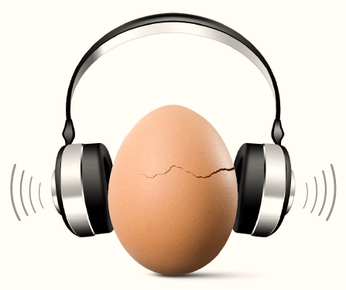

Make Listening Safe

Slide 2
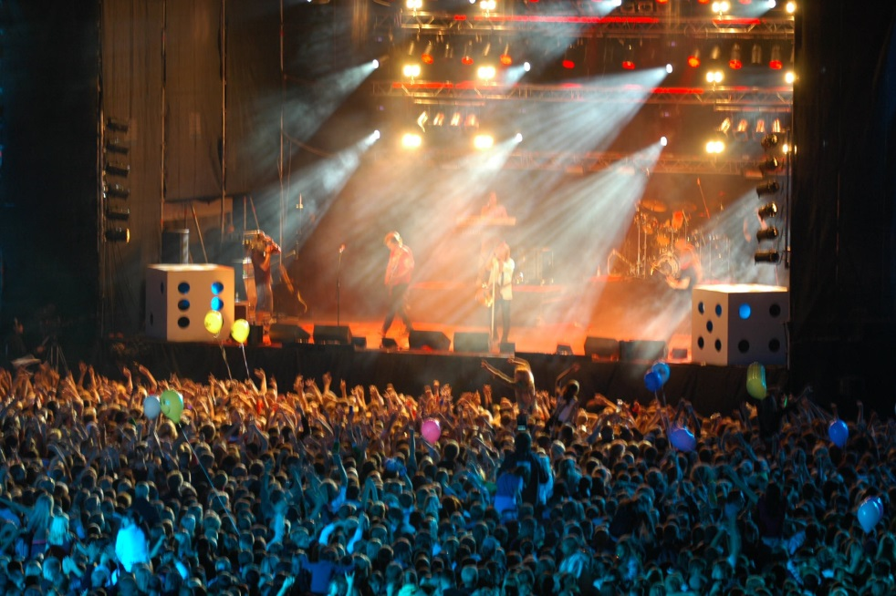
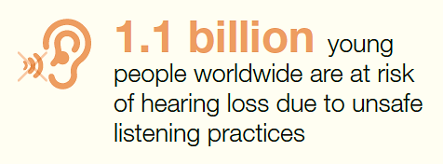

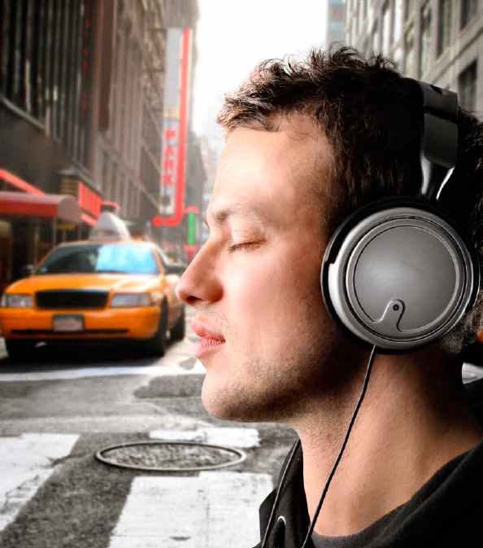
Cause for concern*
Loud volumes
prolonged duration
Regular/habitual exposure
_____________________________________
WHO, 2015

Slide 3
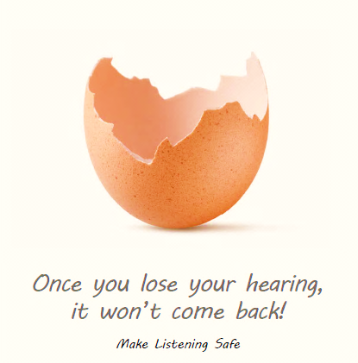
Is action required?
It may be considered that prevention of hearing loss through safe listening practices is the responsibility of the individual.
However, the onus of raising awareness and creating an environment for safe listening lies with the parents, teachers, industry, governments, and other stakeholders.

Slide 4

What is WHO doing?
Launched the Make Listening Safe initiative with the aim to reduce the risk of hearing loss posed by unsafe listening behaviour.
This initiative is part of WHO’s work in the field of prevention, identification and management of hearing loss.

Slide 5
Vision
People of all ages can enjoy listening (to music) with full protection of their hearing.

Slide 6
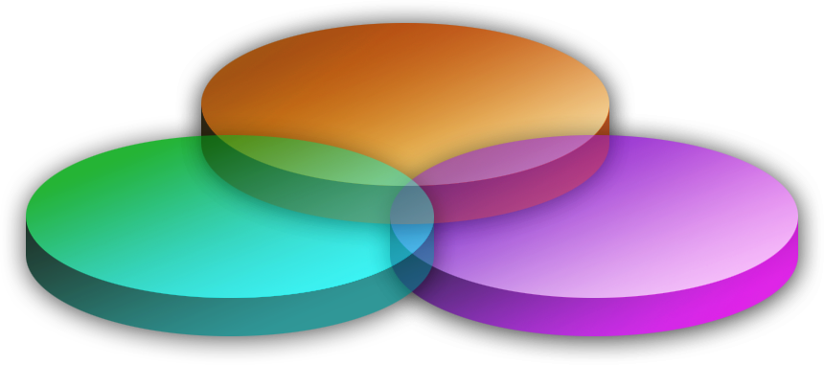
Focus areas
Technology
Health Communication
Research & risk assessment

Slide 7
Key considerations
Hearing loss can occur as a consequence of listening to loud volumes over prolonged periods of time.
The unsafe use of personal audio devices poses a threat to the hearing of millions.
Such hearing loss is permanent but it can largely be prevented through safe listening practices.
Appropriate technology can help to reduce the risk of unsafe listening.
Technology can help to raise awareness and catalyse behaviour change.
Notes:
PURPOSE OF SLIDE – FY05 Director commitments

Slide 8



Technology
Standards for Safe Listening Devices
Safe Listening media player app
A personal audio system (device with earphone) in compliance with standards which serve to minimise the users' risk of acquiring hearing loss, (as a consequence of its use). Under development by ITU
Allow users to monitor their listening level, time and dose; provide information.
Launch of app expected in April 2017.

Slide 9
Health communication
Overall communication strategy to raise awareness on safe listening.
Targeted messages/
principles for integration into standards.
In collaboration with Department of Health communications, University of Luzern

Slide 10
Research and risk criteria
Standardized protocol for assessment of recreational NIHL
Risk assessment and definitions

Slide 11
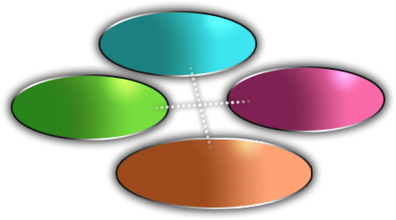


How are we working?
All stakeholders
ITU
Standardization organizations
Advisory groups
Users
Collaborative approach

Slide 12
Coming up
WHO-ITU Consultation on Safe listening Devices: 6-7 March 2017 at WHO HQ, Geneva, Switzerland.
World Hearing Day: 3 March 2017

Slide 13

World Hearing Day 2017 (3 March)
Action for hearing loss: make a sound investment
Key messages on cost of unaddressed hearing loss and cost effectiveness of interventions. http://www.who.int/pbd/deafness/world-hearing-day/en/

